Slide 1
DATA STORAGE

Slide 2
RENCANA KEGIATAN PERKULIAHAN SEMESTER
W | Pokok Bahasan
1 | Pengenalan Teknologi Informasi
2 | Konsep Sistem Komputer & Pengenalan Perangkat Keras
3
4 | Data Storage
5 | Perangkat Lunak
6
7 | Data dan Informasi
8 | Ujian Tengah Semester
W | Pokok Bahasan
9 | Komputasi Pemrograman
10
11 | Rekayasa Perangkat Lunak
12 | Komunikasi data & Jaringan Komputer
13
14 | Etika dan dampak sosial teknologi informasi
15 | Teknologi Terkini / Advance Topik
16 | Ujian Akhir Semester

Slide 3
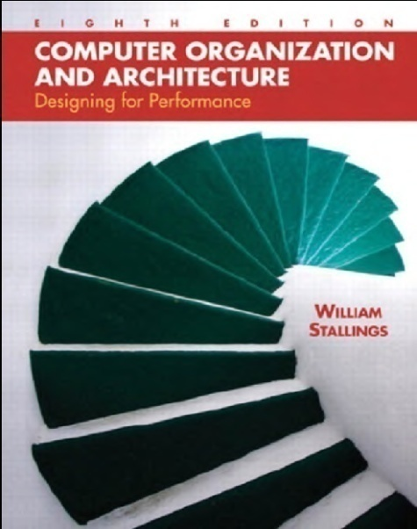

Reference
William Stallings – Computer Organization and Architecture : Designing for Performance 8th Edition (2010)
J. Glenn Brookshear – Computer Science : An Overview 11th Edition (2011)

Slide 4
Review Last Week
Three Key Concept of Computer System
Component of Hardware
Component of CPU
System Software
Application Software

Slide 5
Outline
Sistem Bilangan
Representasi informasi dalam bit
Main Memory
Mass Storage

Slide 6
Sistem Bilangan
Decimal
Binary
Hexadecimal
Converting Binary, Hexadecimal, Octal and Decimal
Octal

Slide 7
Decimal
Have a base, or radix of 10
Each digit in the number is multiplied by 10 raised to a power corresponding to the digit’s position
Ex :
83
4728
10009

Slide 8
Decimal
83 = (8 x 10¹) + (3 x 10⁰)
4728 = (4x10³) + (7x10²) + (2x10¹) + (8 x 10⁰)
10009 = (1x10⁴) + (0x10³) + (0x10²) +
= (0 x 10¹) + (9 x 10⁰)

Slide 9
Binary
Only 2 digits, 1 and 0
Numbers in the binary system are represented to the base 2
Ex :
0₍₂₎
1₍₂₎
0101₍₂₎
1010₍₂₎

Slide 10
Decimal to Binary
3₍₁₀₎ = …₍₂₎
128 | 64 | 32 | 16 | 8 | 4 | 2 | 1
2⁷ | 2⁶ | 2⁵ | 2⁴ | 2³ | 2² | 2¹ | 2⁰

Slide 11
Decimal to Binary
3₍₁₀₎ = …₍₂₎
3₍₁₀₎ = 11₍₂₎
128 | 64 | 32 | 16 | 8 | 4 | 2 | 1
2⁷ | 2⁶ | 2⁵ | 2⁴ | 2³ | 2² | 2¹ | 2⁰
0 | 0 | 0 | 0 | 0 | 0 | 1 | 1

Slide 12
Decimal to Binary
24₍₁₀₎ = …₍₂₎
24₍₁₀₎ = 11000₍₂₎
128 | 64 | 32 | 16 | 8 | 4 | 2 | 1
2⁷ | 2⁶ | 2⁵ | 2⁴ | 2³ | 2² | 2¹ | 2⁰
0 | 0 | 0 | 1 | 1 | 0 | 0 | 0

Slide 13
Decimal to Binary
255₍₁₀₎ = …₍₂₎
255₍₁₀₎ = 11111111₍₂₎
128 | 64 | 32 | 16 | 8 | 4 | 2 | 1
2⁷ | 2⁶ | 2⁵ | 2⁴ | 2³ | 2² | 2¹ | 2⁰
1 | 1 | 1 | 1 | 1 | 1 | 1 | 1

Slide 14
Binary to Decimal
101₍₂₎ = ………..₍₁₀₎
1001₍₂₎ = ………..₍₁₀₎
1111₍₂₎ = ………..₍₁₀₎

Slide 15
Binary to Decimal
101₍₂₎ = …₍₁₀₎
1 | 0 | 1

Slide 16
Binary to Decimal
101₍₂₎ = …₍₁₀₎
1 | 0 | 1
2² | 2¹ | 2⁰

Slide 17
Binary to Decimal
101₍₂₎ = …₍₁₀₎
101₍₂₎ = (1x2²) + (0x2¹) + (1x2⁰)
= 4 + 0 + 1 = 5₍₁₀₎
1 | 0 | 1
2² | 2¹ | 2⁰
4 | 0 | 1

Slide 18
Hexadecimal
Binary digits are grouped into sets of four
Base 16
Ex :
2C₍₁₆₎
DE2₍₁₆₎
A₍₁₆₎
AA₍₁₆₎
69F₍₁₆₎

Slide 19
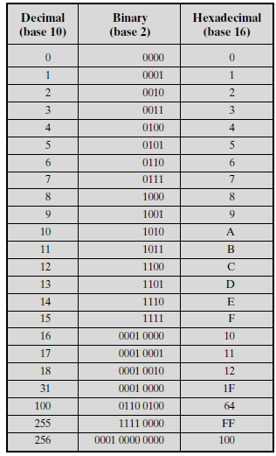

Slide 20
Hexadecimal to Decimal
2C₍₁₆₎ = …₍₁₀₎
2C₍₁₆₎ = (2x16¹) + (12x16⁰)
= 32 + 12
= 44₍₁₀₎

Slide 21


Decimal to Hexadecimal
44₍₁₀₎ = …₍₁₆₎
44₍₁₀₎ = 2C₍₁₆₎
12 = C

Slide 22
Hexadecimal to Binary
2C₍₁₆₎ = …₍₂₎
2C₍₁₆₎ = 00101100₍₂₎
2 | C (12)
0010 | 1100

Slide 23
Binary to Hexadecimal
00101100₍₂₎ = …₍₁₆₎
00101100

Slide 24
Binary to Hexadecimal
00101100₍₂₎ = …₍₁₆₎
00101100
0010 | 1100

Slide 25
Binary to Hexadecimal
00101100₍₂₎ = …₍₁₆₎
00101100₍₂₎ = 2C₍₁₆₎
00101100
0010 | 1100
2 | 12 / (C)

Slide 26
Octal
Binary digits are grouped into sets of three
Base 8
Ex :
545₍₈₎
5545₍₈₎
55₍₈₎

Slide 27
Octal to Decimal
545₍₈₎ = …₍₁₀₎
5 | 4 | 5

Slide 28
Octal to Decimal
545₍₈₎ = …₍₁₀₎
5 | 4 | 5
8² | 8¹ | 8⁰

Slide 29
Octal to Decimal
545₍₈₎ = …₍₁₀₎
545₍₈₎ = (5 x 8²) + (4 x 8¹) + (5 x 8⁰)
= 320 + 32 + 5 = 357₍₁₀₎
5 | 4 | 5
8² | 8¹ | 8⁰
320 | 32 | 5

Slide 30



Decimal to Octal
357₍₁₀₎ = …₍₈₎
357₍₁₀₎ = 545₍₈₎

Slide 31
Octal to Binary
545₍₈₎ = …₍₂₎
5 | 4 | 5

Slide 32
Octal to Binary
545₍₈₎ = …₍₂₎
545₍₈₎ = 101100101₍₂₎
5 | 4 | 5
101 | 100 | 101

Slide 33
Binary to Octal
101100101₍₂₎ = …₍₈₎
101100101

Slide 34
Binary to Octal
101100101₍₂₎ = …₍₈₎
101100101
101 | 100 | 101

Slide 35
Binary to Octal
101100101₍₂₎ = …₍₈₎
101100101₍₂₎ = 545₍₈₎
101100101
101 | 100 | 101
5 | 4 | 5

Slide 36
Octal to Hexadecimal
545₍₈₎ = …₍₁₆₎
545₍₈₎ = 165₍₁₆₎
5 | 4 | 5
101 | 100 | 101
0001 | 0110 | 0101
1 | 6 | 5

Slide 37
Hexadecimal to Octal
165₍₁₆₎ = …₍₈₎
165₍₁₆₎ = 545₍₈₎
1 | 6 | 5
0001 | 0110 | 0101
000101100101
5 | 4 | 5

Slide 38
Representasi Informasi dalam Bit
Text
Image

Slide 39
Representasi Text dalam Bit
Pada tahun 1940 – 1950 an banyak jenis kode yang dirancang dan digunakan dengan peralatan yang berbeda, hal ini menyebabkan meluasnya masalah komunikasi.
Untuk mengatasi masalah ini American Standard National Institute (ANSI) mengadopsi sistem American Standard Code for Information Interchange (ASCII).

Slide 40
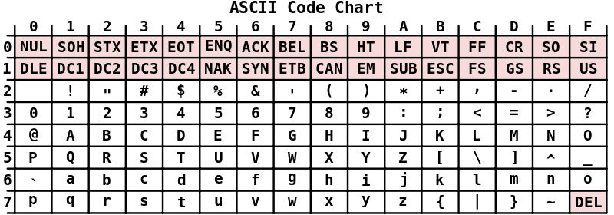
Representasi Text dalam Bit
Kode ASCII menggunakan pola bit dengan panjang 7 bit untuk merepresentasikan huruf kecil, huruf kapital dalam alfabet Inggris, angka 0-9, tanda baca, control information seperti carriage return(CR), line feed(LF), dan DEL.

Slide 41
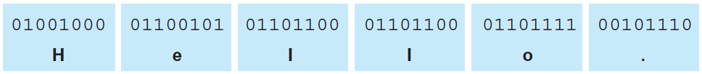
Contoh Representasi Text

Slide 42
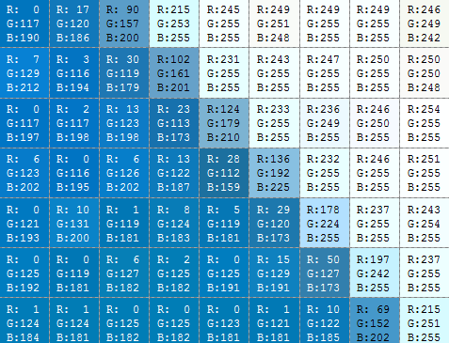

Representasi Citra dalam Bit
Red : 69₍₁₀₎ = 01000101₍₂₎
Green : 152₍₁₀₎ = 10011000₍₂₎
Blue : 202₍₁₀₎ = 11001010₍₂₎

Slide 43
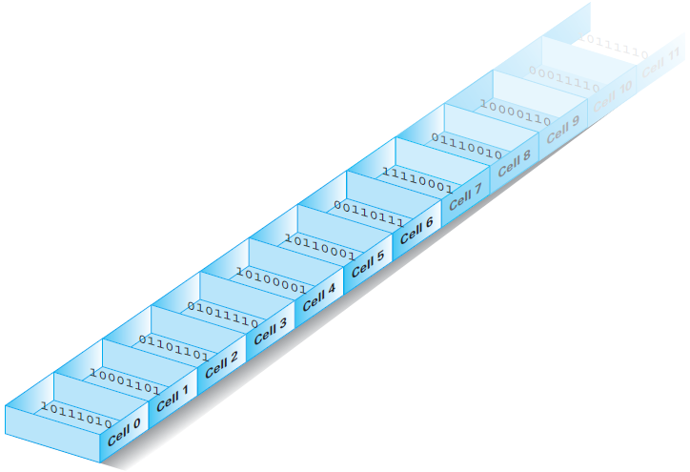
Main Memory
Penyusunan memory cell berdasarkan alamat

Slide 44
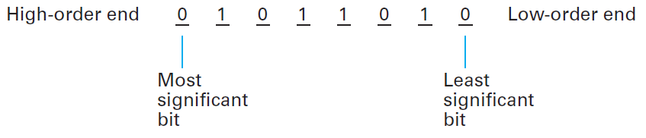
Main Memory
Pengaturan memory cell berukuran byte (8 bit)
Most significant bit : the leftmost bit
Least significant bit : the rightmost bit

Slide 45
Mass Storage
Most computers have additional memory devices
Example :
Magnetic disks
CDs
DVDs
Magnetic tapes
Flash drives

Slide 46
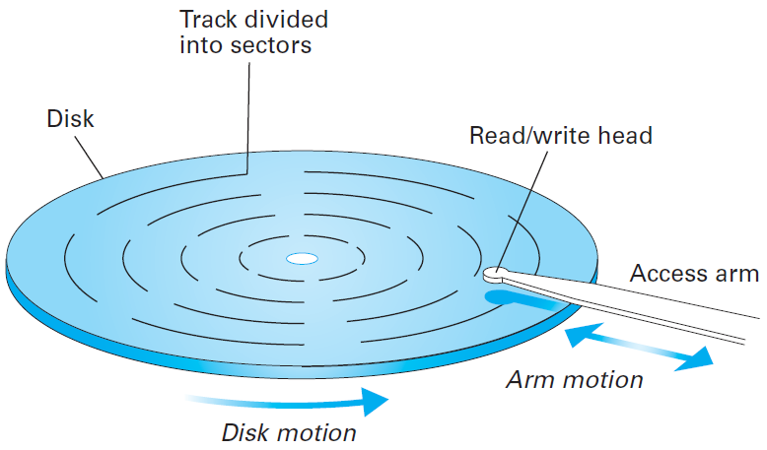
Magnetic System
Magnetic Disk

Slide 47
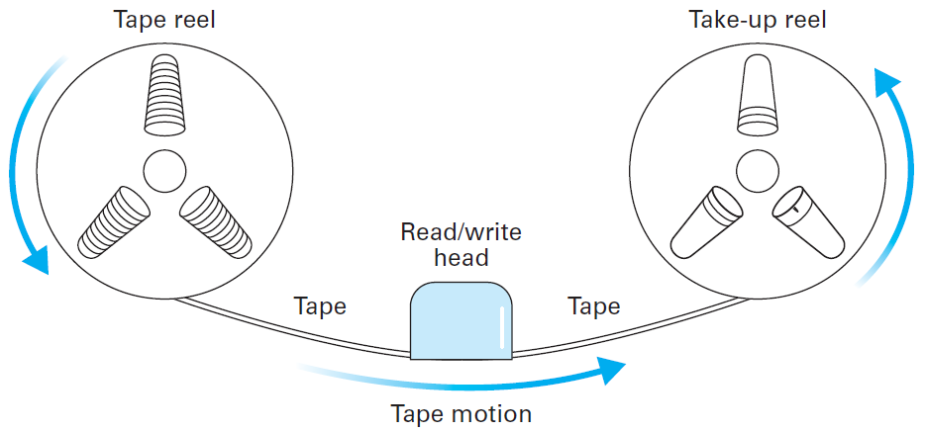
Magnetic System
Magnetic Tape

Slide 48
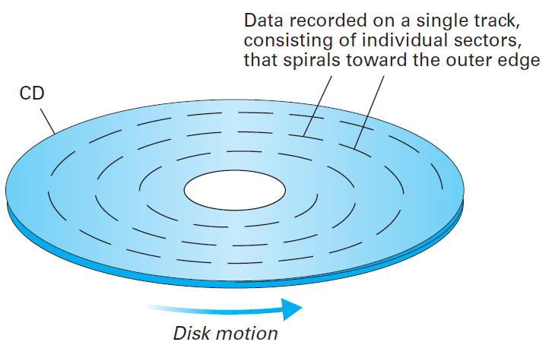
Optical System

Slide 49
TERIMA KASIH

